Slide 1
The Android Software Stack
Presented By :- SNEHAL TAWAR

Slide 2
Introduction :
Overview
Linux Kernel
Libraries
Android Runtime
Application Framework
Applications
References

Slide 3
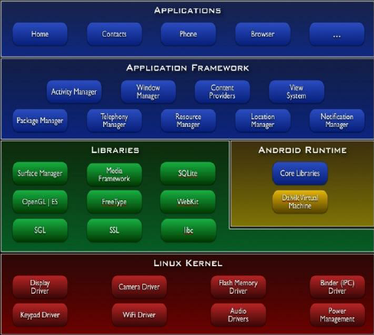

Slide 4

Linux Kernel
Linux Kernel is heart of the android architecture. It manages all the available drivers such as display drivers, camera drivers, Bluetooth drivers, audio drivers, memory drivers, etc. which are required during the runtime.
The kernel also provides an abstraction layer between the hardware and the remainder of the stack.
It is responsible for management of memory, power, devices etc.
The features of Linux kernel are:
Security: The Linux kernel handles the security between the application and the system.
Memory Management: It efficiently handles the memory management thereby providing the freedom to develop our apps.
Process Management: It manages the process well, allocates resources to processes whenever they need them.
Network Stack: It effectively handles the network communication.
Driver Model: It ensures that the application works properly on the device and hardware manufacturers responsible for building their drivers into the Linux build

Slide 5


Libraries
Running on top of the kernel, Android includes various C/C++ core libraries such as libc and SSL, as well as the following:
A media library for playback of audio and video media
A surface manager to provide display management
Graphics libraries that include SGL and OpenGL for 2D and 3D graphics
SQLite for native database support
SSL and WebKit for integrated web browser and Internet security

Slide 6



Android Runtime
The run time is what makes an Android phone an Android phone rather than a mobile Linux implementation.
Including the core libraries and the Dalvik VM, the Android run time is the engine that powers your applications and, along with the libraries, forms the basis for the application framework.
Core libraries — Although most Android application development is written using the Java language, Dalvik is not a Java VM. The core Android libraries provide most of the functionality available in the core Java libraries, as well as the Android specific libraries.
Dalvik VM — Dalvik is a register-based Virtual Machine that’s been optimized to ensure that a device can run multiple instances efficiently. It relies on the Linux kernel for threading and low-level memory management.

Slide 7



Application Framework
The application framework provides the classes used to create
Android applications. It also provides a generic abstraction for hardware access and manages the user interface and application resources.
Some of these interfaces include:
Activity Manager:
It manages the activity lifecycle and the activity stack.
Telephony Manager:
It provides access to telephony services as related subscriber information, such as phone numbers.
View System:
It builds the user interface by handling the views and layouts.
Location manager:
It finds the device’s geographic location.

Slide 8





Applications
Applications is the top layer of android architecture.
The pre-installed applications like home, contacts, camera, gallery etc and third party applications downloaded from the play store like chat applications, games etc. will be installed on this layer only. It runs within the Android run time with the help of the classes and services provided by the application framework

Slide 9
References :
PROFESSIONAL Android™ 4 Application Development, Reto Meier, John Wiley & Sons, Inc. 2012.
https://www.geeksforgeeks.org/android-architecture/
https://www.wikipedia.com/android-architecture/
http://yuliana.lecturer.pens.ac.id/Android/Buku/professional_android_4_application_development.pdf

Slide 10
THANK YOU !

